Slide 1
Learning to walk a quadruped robot
Continuous Control with Reinforcement Learning

Slide 2
Problem Description
Given:
a robot with 4 legs, each leg with 2 limbs
Upper limbs move(rotate) horizontally, lower legs move vertically

Slide 3
Goal
Make the robot learn to move its 8 limbs together in such a way that it can walk
Classical robotics approach for solving such ‘continuous control’ tasks: mathematically model gait kinematics. Not adaptable or generalizable, difficult to control when something fails, requires human intervention
Machine learning approach: achieve the same goal without explicitly providing it with any information about how to walk. Adapts to different environments(example- terrains), can learn to overcome obstacles, depends on well-defined objectives

Slide 4
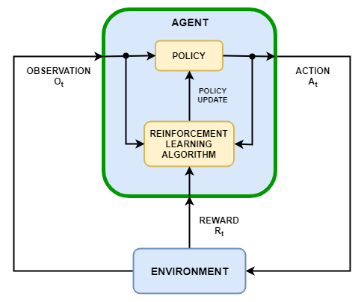
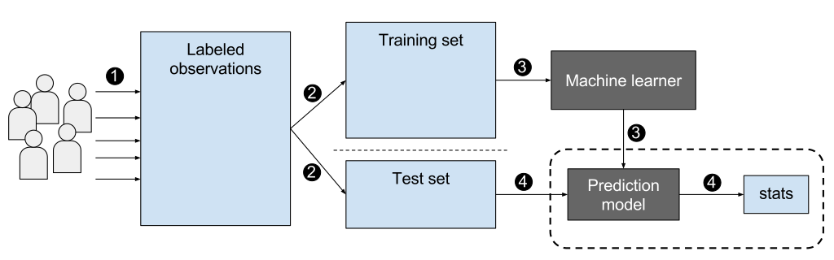
Supervised machine learning | Reinforcement learning
Given input and output, find an accurate mapping from input to output | Given an agent that interacts with the environment and makes observations, find ‘good’ action sequences, i.e. that maximise the reward for the agent
Dataset is fixed | Data (observations) is changing based on actions taken by the agent
Stable learning | Unstable learning, difficult to define MDPs, difficult to simulate ‘context’ of the environment

Slide 5
Implementation
Unity : 3D simulation
ML-agents : framework for machine learning in Unity
Training : stable baseline algorithms include PPO and Actor-Critic methods such as DDPG.
RL algorithms are based on different intuitions towards complex problem-solving. But the general idea is to explore the action space for more rewarding behaviours, while also exploiting the rewarding behaviours already discovered through experience.
‘Learning’ step is the same as traditional machine learning, using gradient descent / other optimization methods.

